Slide 1
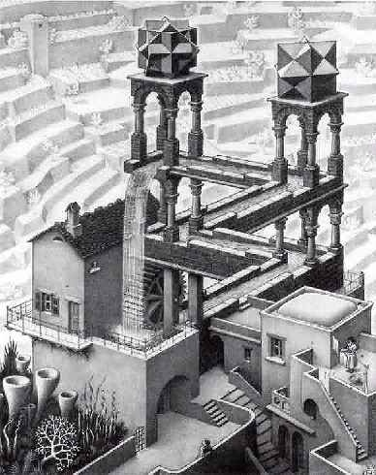
Energy: No Such Thing as a Free Lunch
Eric Prebys

Slide 2
Motivation for This Lecture
The basic facts:
The energy consumption of the human race is increasing.
Soon, the developing world will pass the US and Western Europe in energy usage.
Our reliance on fossil fuels is impacting our environment, perhaps catastrophically.
Fossil fuels will run out – maybe in 10 years, maybe in 100, but they will run out.
The current emphasis on “going green” has raised the stakes for alternative energy sources:
Scientifically, this is very exciting, but…
It will also not be lost on the con men.

Slide 3

Is this lecture necessary?
Unfortunately, Homer’s conceptual understanding is well above average!

Slide 4
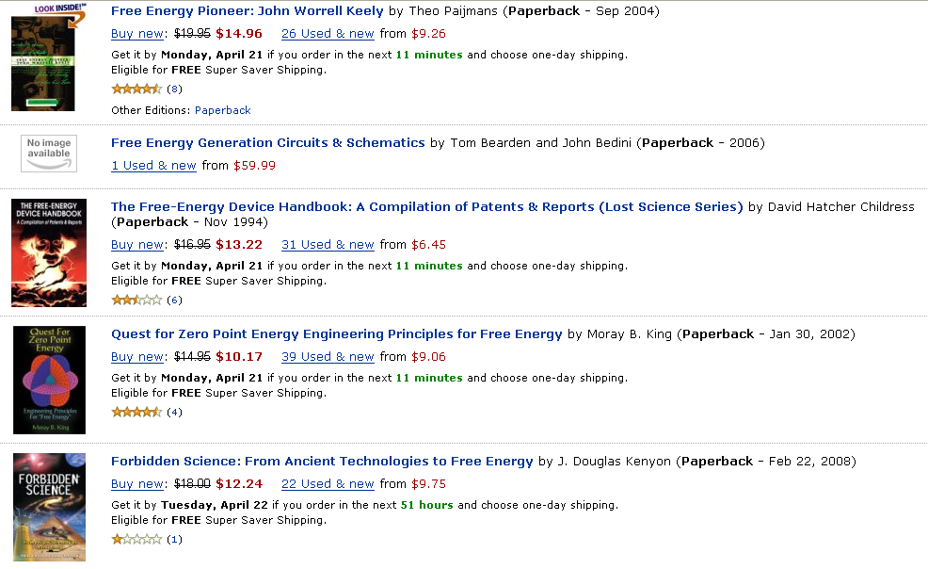
Evidence: Amazon search "free energy"
Top 5:

Slide 5
Working definition: How free is "free"?
For the purposes of this discussion, “free energy” refers to transformative technologies that:
Can be implemented on an individual basis
i.e. non-centralized
Will enable dramatic reduction in domestic and/or transportation energy expenses
say, a factor of four or more
Do not require a lifestyle change
Involve only modest capital costs
Pay for themselves in less than a year or so
Some examples which do NOT qualify:
Trading in your Hummer for a motorcycle
Lifestyle change
Converting your home to 100% solar
Takes several years to recover the cost

Slide 6
Types of “free energy”
Perpetual Motion: A device which produces useable output energy with no input energy or fuel.
To the extent science declares anything “impossible”, this is impossible.
Dramatically improved efficiency in utilizing an existing power source.
A legitimate idea, but there limits
A new source of energy or radically different way of tapping and established source of energy
Examples: cold fusion, zero-point energy, hydrinos, etc.
In many cases, claims of the second two types really imply the first

Slide 7
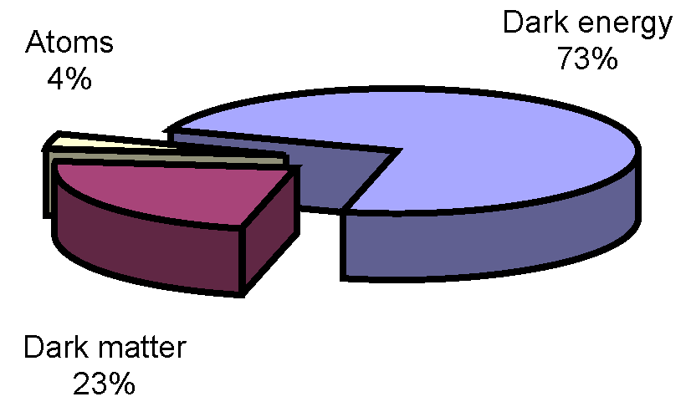
How can we be so sure or ourselves?
After all, we only know what 4% of the universe is made of.
Can’t there be some sort of energy source in the other 96%?
Maybe, but even if we don’t know what 96% is, we know a lot about what it isn’t.

Slide 8
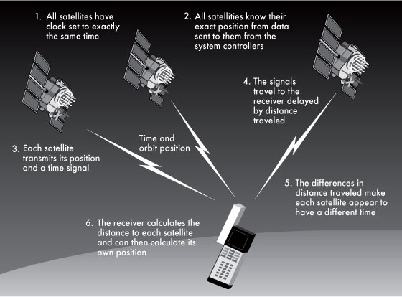
Consider the GPS
For a GPS to work, we have to understand
The chemistry of the fuel
The dynamics of the launch and orbit
The physics of the onboard atomic clocks
The E&M involved in generating and transmitting the signal
The Special and General Relativity corrections required
38 μsec = 11.4 km/day error without them!
And then there’s all the physics needed to put that much computing in your hand.
None of this would work if unknown particles and forces interacted significantly with ordinary matter.

Slide 9

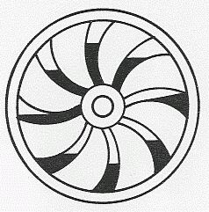
Early perpetual motion machines
Some of the oldest perpetual motion machines were documented by the Indian author Bhaskara (c. 1159), who made sketches of something called the “Persian Wheel”
This device used flowing water (or sand) to create a “perpetual imbalance”
Still find people claiming to build these on FaceBook

Slide 10
Perpetual motion and physics
We need to examine these early claims in the context of the time.
Because there was no theoretical framework to rule out these machines, these people were behaving as good scientists.
The fact they didn’t work was an important piece of experimental evidence.
All of this changed with Newton
F=ma and the “universal law of gravitation” held the mathematical key to ruling out all of these “imbalance” type perpetual motion machines in one fell swoop.

Slide 11
Physics and energy
In the 18th and 19th centuries, a great deal of physics was done to formalize the concepts of work, energy, and conservation laws.
The non-observation of perpetual motion was taken as input to these theories.
The 19th century saw the development of thermodynamics
Term originally coined by James Joule to describe the science of heat and power
Generalized to cover all physical systems
Lays out the specifics of the relationship between physical systems and usable energy
As new types of physics were discovered, the still fit into this paradigm
Electricity and Magnetism
Relativity
Nuclear energy
Quantum Mechanics

Slide 12
First Law of Thermodynamics
Every system is characterized by an energy (U)
This law is also known as “Conservation of Energy”
Change in energy
“Heat” put into system
Work done by system

Slide 13
Second Law of Thermodynamics
Not all energy is useable!!
Every system is characterized by an “entropy” (S)
A measure of energy and degree of order
Generally “Low entropy” = high energy and high order
The entropy of a “closed” system can never decrease.
Can only get work out of system in a transition to a higher entropy state. (S₂>S₁)

Slide 14

Second Law and Heat
Entropy increases as heat flows from high to low temperature
We can extract work when heat flows from high temperature to low temperature
We have to do work to move heat from low temperature to high temperature.

Slide 15
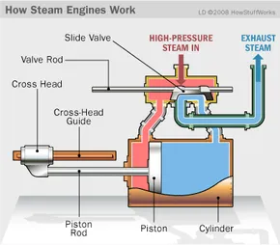
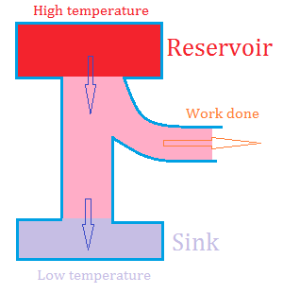
2nd law: getting energy out…
Steam engine:
A source of heat makes stream
The steam pushes a piston, cooling in the process.
The steam is then exhausted to a cooler reservoir

Slide 16
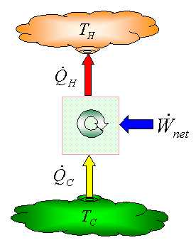
2nd Law: doing work to move heat
Air conditioning
This is why you can’t use your refrigerator to cool your house!
Work is done to move heat from inside the house to the radiator unit outside the house.
The heat radiated outside the house is equal to the heat removed from the house plus the work it took to move it.

Slide 17
The Bottom Line
To date, no violation of the Laws of Thermodynamics has ever been observed
Period.
Exclamation point!
Red box around it

Slide 18
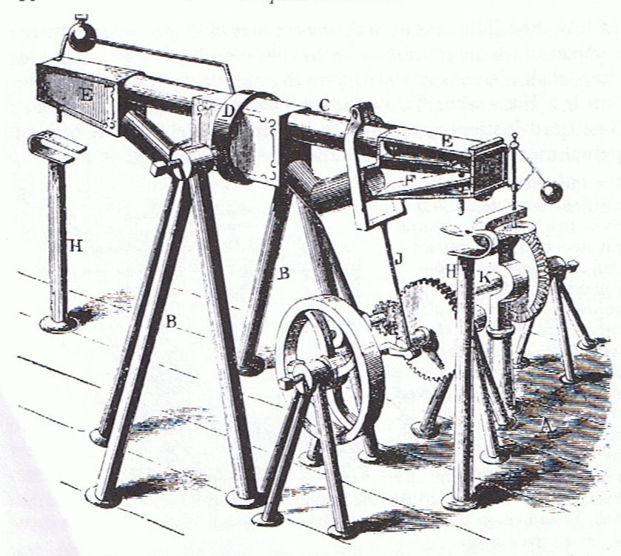
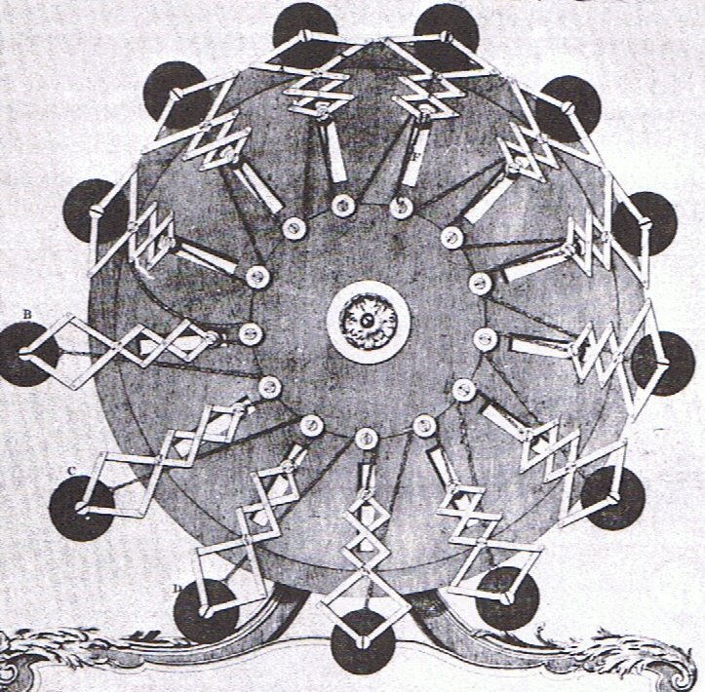
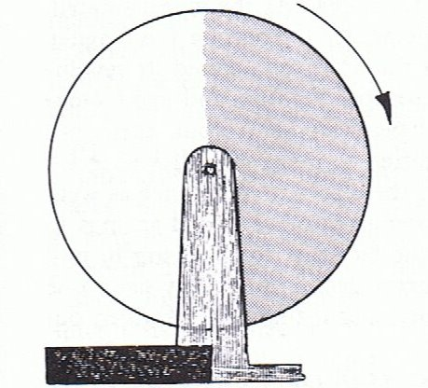
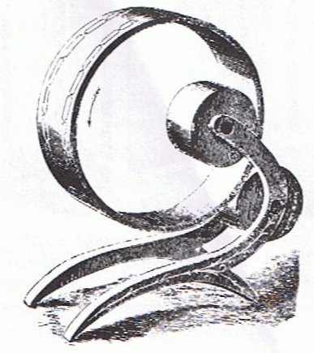
Interest continued, undaunted by facts*
Gravitational imbalance…
*Illustrations taken from A.W.J.G Ord-Hume, “Perpetual Motion: The History of an Obsession”
Gravitational shield!

Slide 19
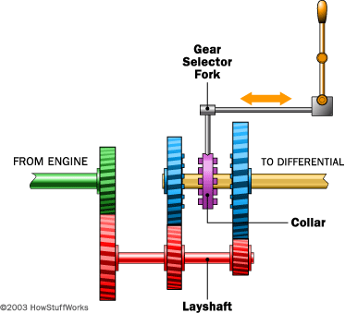
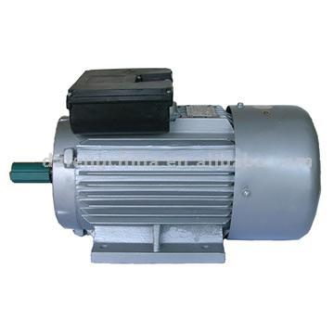
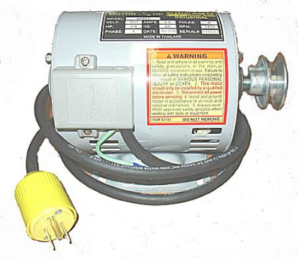
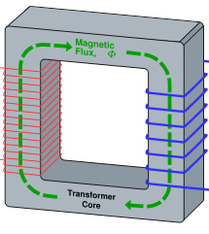

Perpetual Motion 101 (electricity example)
Start with a motor…
which turns a generator…
which powers the motor…
with perhaps some left over!
Doesn’t work??
Try adding some gears…
or maybe a transformer
etc, etc, etc…

Slide 20
Redefining the problem
Instead of talking about “perpetual motion”, talk about “over-unity”; that is, gearboxes, transformers, etc, in which the power out is greater than the power in
Physically, P_{out}≤P_{in} - ALWAYS
“Over-unity” = “perpetual motion” - PERIOD
torque
current
angular frequency
voltage

Slide 21
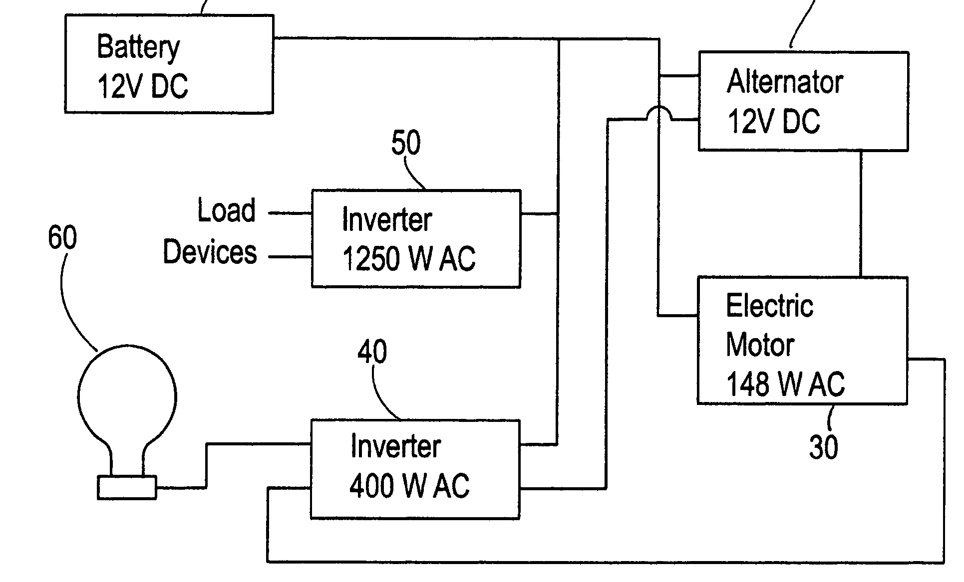
In case you thought my example was silly
US Patent #7,095,126: ”Internal Energy Generating Power Source” (2006)
ABSTRACT
An external power source such as a battery is used to initially supply power to start an alternator and generator. Once the system has started it is not necessary for the battery to supply power to the system. The battery can then be disconnected. The alternator and electric motor work in combination to generator (sic) electrical power.

Slide 22
Speaking of patents
A partial list of US patents purported to support perpetual motion:
2,006,676: “Electrolytic Carburetor” (Garrett Carburetor)
Launched a whole kook industry
4,074,153: “Magnetic propulsion device”
4,151,431: “Permanent magnet motor”
4,215,330: “Permanent magnet propulsion system”
6,246,561: “Methods for controlling the path of magnet flux…”
6,362,718: “Motionless electromagnetic generator”
More about this one later
6,523,646: “Spring driven apparatus”
6,526,925: “Piston driven rotary engine”
6,962,052: “Energy generation mechanism, device and system”
7,095,126: “Internal energy generating power source”
The one we just talked about

Slide 23
Patents and perpetual motion
The Patent Office has had so much trouble with perpetual motion machine patents that it’s developed special rules.:
“With the exception of cases involving perpetual motion, a model is not ordinarily required by the Office to demonstrate the operability of a device. If operability of a device is questioned, the applicant must establish it to the satisfaction of the examiner”
- 35 U.S.C 101 (Examiners’ Handbook)
Translation: “If the Patent Office didn’t ask for a working model, they didn’t believe it was a perpetual motion machine”.

Slide 24
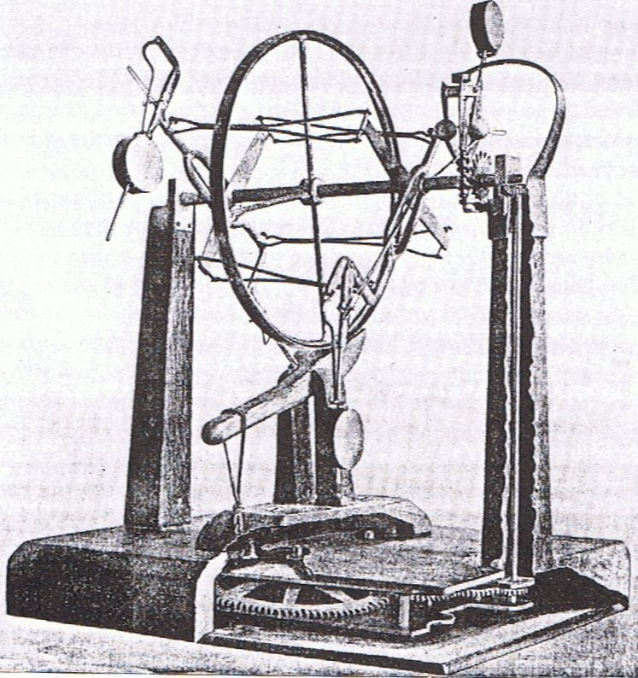
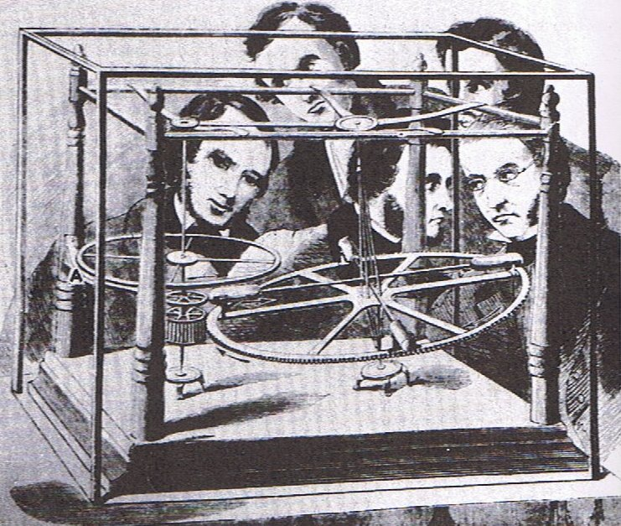
Early frauds
Perpetual motion was mostly an intellectual curiosity, until the Industrial Revolution convinced people of its “value”
J.M. Aldrich’s machine ran on hidden springs (1899)
E.P. Willis’ “overbalanced wheel” ran on hidden compressed air. (1850’s)

Slide 25
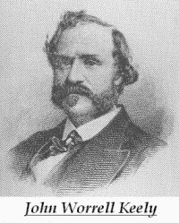
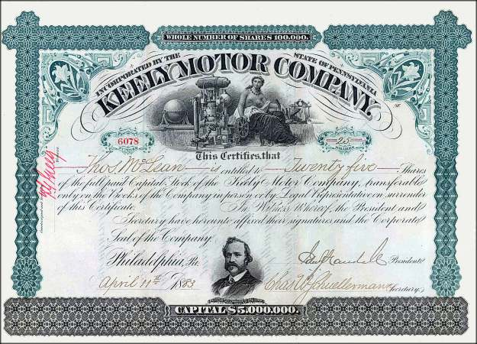
John Keely: the father of the free energy scam
There were numerous perpetual motion frauds in the 19th century, but most were pretty small scale
In 1872, John E. Worrel Keely claimed to have discovered a new type of motor, which used some sort of musical resonance to extract energy from the “luminiferous ether”.
He formed the “Keely Motor Company”, began giving public demonstrations and selling stock.

Slide 26
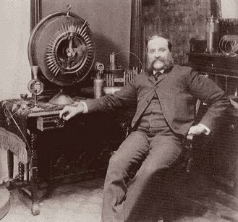
Keely and his times
In the context of the times, Keely’s claims were not all that unbelievable:
This was before Special Relativity, and “Luminiferous Ether” was the hypothetical fluid through which electromagnetic waves, including light, propagated.
This was the golden age of empirical physics, and finding a way to extract energy from this medium was not yet experimentally ruled out.
Keely’s behavior, on other hand, should have raised some alarm bells
He never published any data regarding the mode of operation of his machine in scientific journals.
He never allowed any independent test or even inspection of his machine.

Slide 27
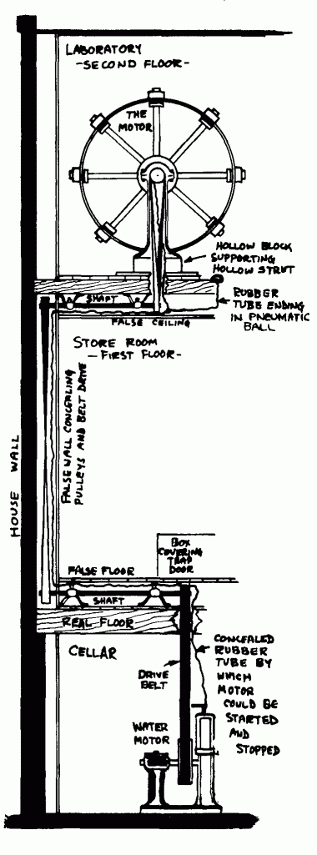
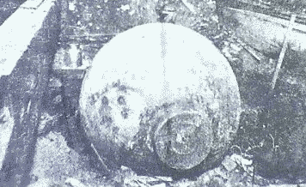
Keely: postmortem
“Scientific American” had always been skeptical of Keely. Following his death, they inspected his home.
They discovered an elaborate system of pipes and hoses, connected to his machines through hollowed out legs on the furniture!
The entire system was powered by a compressed air tank in the basement.

Slide 28
Major classes of modern free energy devices
Motors that run on permanent magnets
Usually find excuses to connect them to batteries
“Over-unity” transformers that put out more electrical power than they take in.
Rather than admit they are selling a perpetual motion machine, they will usually claim to be tapping the “Zero Point Energy” (ZPE)
Engines that run on water
Generally deny being “perpetual motion machines”
Instead claim to split water into H and O with “very high efficiency”
Fancy jars of goo
Cold fusion
Self-charging batteries
Yet more ZPE devices

Slide 29
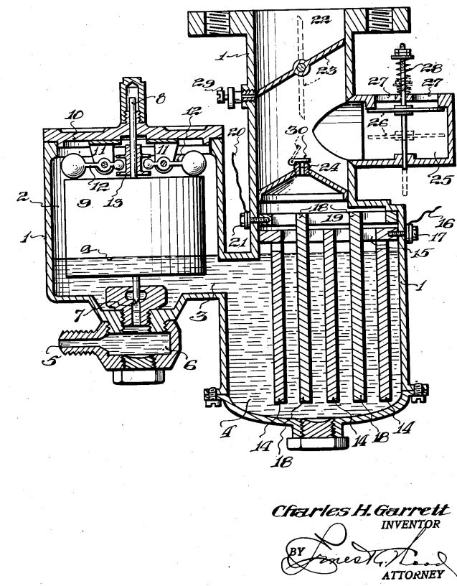
Motors that run on water
Tapping the energy of water is to the “free energy community” what the Philosopher's Stone was to alchemists.
Even Keely himself claimed to have a motor which ran on water in 1890.
A patent was issued in 1935 for the “Garrett Carburetor”, which set the standard for countless water schemes to follow. The principle is quite simple:
Invent an “efficient” way to use electricity to separate water into Hydrogen and Oxygen.
Burn the Hydrogen.
Use a small amount of the energy to generate electricity to produce more Hydrogen.

Slide 30
The problem
Burning Hydrogen and Oxygen produces water.
Remember the First Law of Thermodynamics
An engine that runs on water
Starts with water
Ends with water (i.e. in the same state)
Extracts useable energy
Cars that run on water violate the laws of physics as we know them

Slide 31
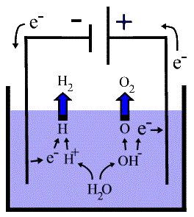
Electrolysis: in the real world
Electrolysis is the process by which electricity is used to break water into Hydrogen and Oxygen
Energy is released when the Hydrogen and Oxygen are recombined , which again produces water
The energy released in recombining the Hydrogen and Oxygen is always less than the energy used in electrolysis.

Slide 32
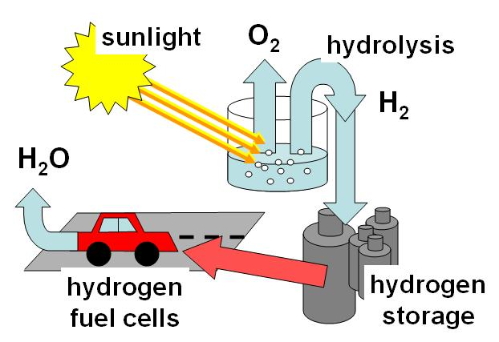
Application of Hydrogen cycle
Hydrogen can be used to store energy from inherently intermittent sources like wind and solar
Lots of practical problems to solve, but no problem with the laws of physics

Slide 33
A Few Examples of Energy from Water Claims
Stanley Meyer
Claimed to have a dune buggy that ran on water in the 1980s.
Never let anyone inspect it.
Patented everything before his death in 1986, but no one can make it work.
Dennis Klein
In 2002, developed “Aquygen”, which he claimed could extract energy from water.
Started me on this obsession.
I’ve moved this to my “Media” lecture, because they were very complicit.
Genesis World Energy
Major investment scam started in 2002.
Promised cars and home generators running on only water.
The owner, Patrick Kelly, was sentenced to five years in jail in 2006.

Slide 34
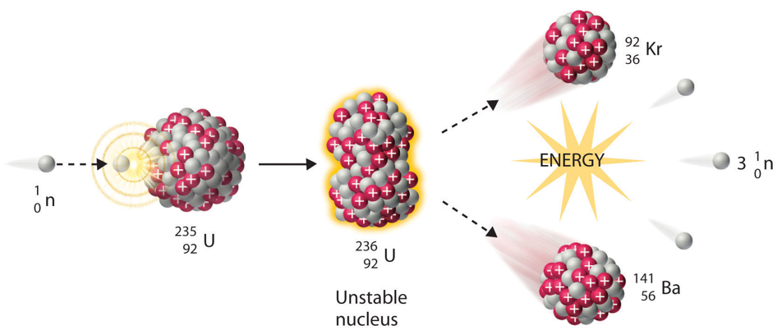
Digression: Nuclear Fission
All existing nuclear plants extract energy from nuclear fission; that is, breaking about heavy nuclei in a chain reaction.

Slide 35
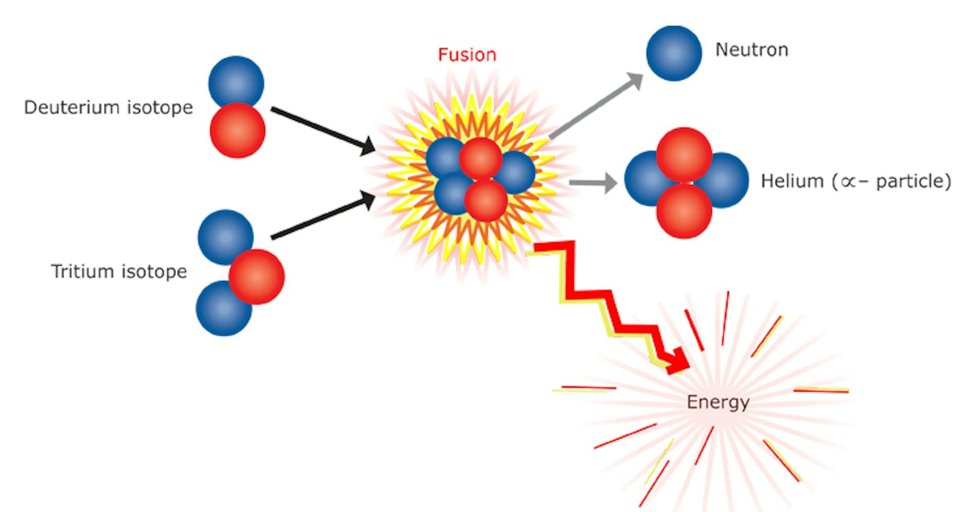
Nuclear Fusion
We could in principle get more and cleaner energy energy by fusing lighter nuclei
Unfortunately, it’s very hard to do this.
We had a fission reactor before we had a fission bomb.
We’ve had nuclear fusion (thermonuclear) bombs for over 70 years, but we’re still not even close to a reactor.

Slide 36
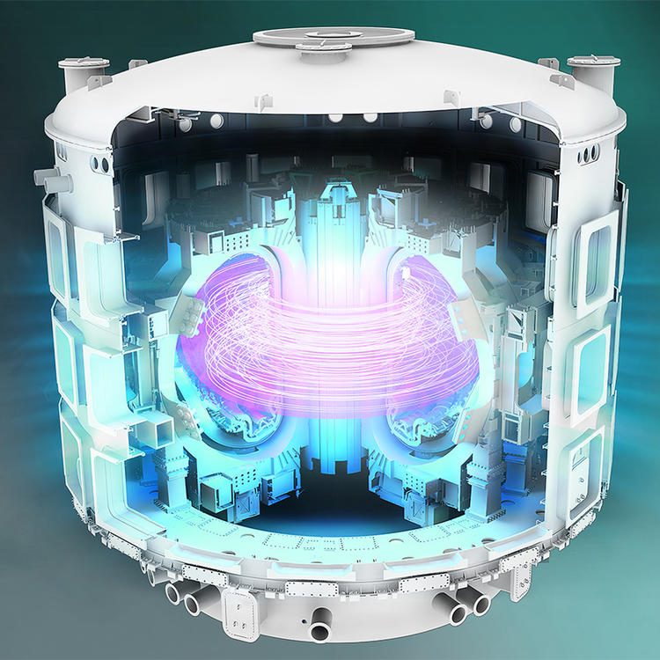
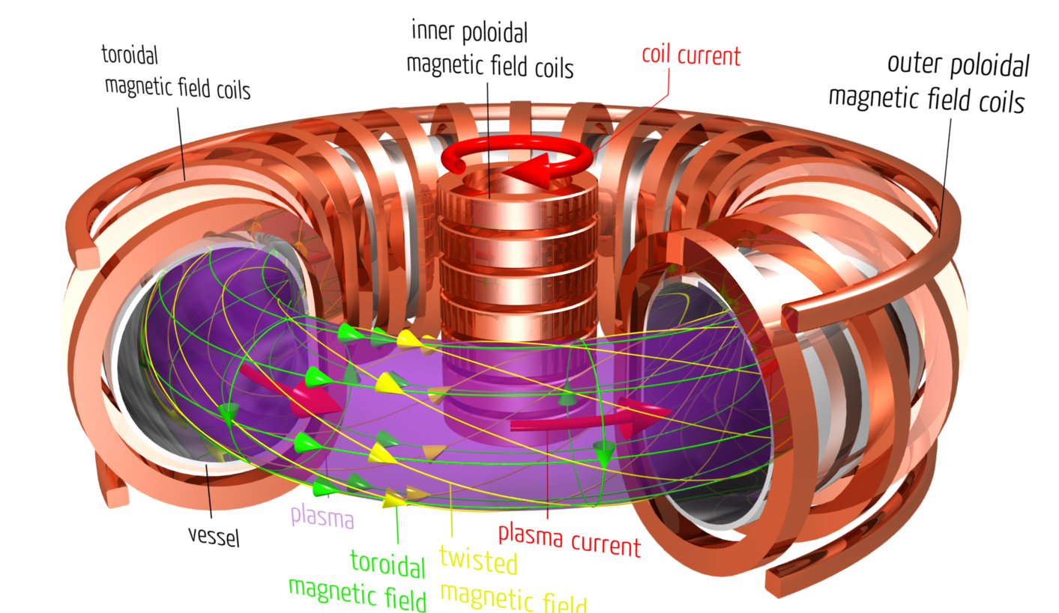
Magnetic Confinement Fusion
Use magnetic fields to keep particles together long enough to fuse
Example: ITER in France
Planning started in 1978
Construction started in 2007
Scheduled to demonstrate sustained fusion in 2039 (!!)
Demonstration machine only. Not a power reactor.

Slide 37
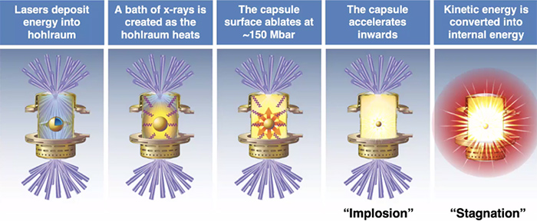
Inertial Confinement Fusion
Compress nuclei with powerful lasers.
Fusion happens before they can fly apart.
Most successful facility is the National Ignition Facility at Lawrence Livermore National Lab.
192 HUGE lasers
Some recent successes, but no clear path to a power plant
But what if there were an easier way…

Slide 38
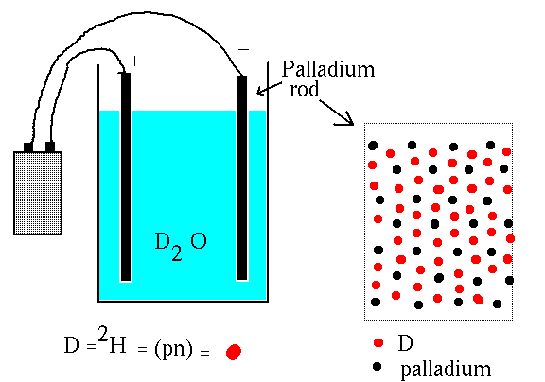
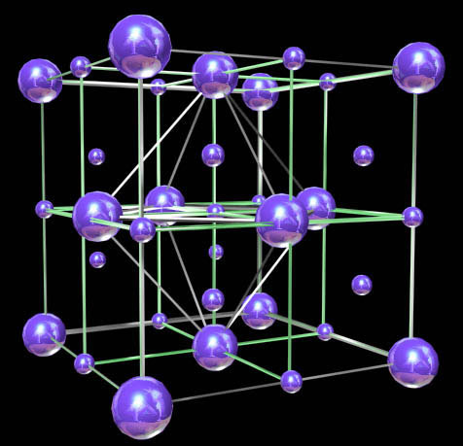
Cold fusion: the revolution that wasn't
In 1989, two teams announced they had seen evidence for nuclear fusion at room temperature taking place in a Palladium rod which had been loaded with Deuterium from heavy water.
One team, Pons and Fleischmann, claimed energy release at a level which promised practical application.
Although difficult to reconcile with solid state physics, there’s nothing a priori impossible about the claim, and theorists struggle to accommodate the result.

Slide 39

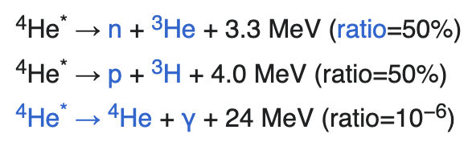
Problems Right Out of the Gate
These are hard measurements, because palladium is very reactive
Ordinary D-D fusion occurs through the reaction
But the helium is excited and decays to
P & F claimed they say 4000 neutrons/second, BUT
Their clamed excess heat of 1 Watt should have produced 1012 neutrons/second
Which would have been lethal!
Should see neutrons
Should see helium and gamma rays

Slide 40
The road from fallacy to fraud
At the 1989 APS meeting in Baltimore, no one was able to confirm Pons and Fleischmann’s results.
Nathan Lewis, a chemist at Cal Tech, offered an explanation for all of their results in terms of sloppy experimental techniques:
Pons and Fleischmann did not attend, as they were busy soliciting funds.
In addition, obvious cross-checks were not done
Control test with ordinary water
Assay for Helium, the product of fusion
Cold fusion was dead – scientifically anyway.

Slide 41

And yet…
Cold fusion is alive and well in the minds of believers
There are magazines, websites, books, products, and conferences.
Still makes the news ~once/year
“60 Minutes” episode even did an episode on it.

Slide 42
What Became of Pons and Fleischman?
They continued to solicit funding to do “research”, finally settling into a lavish “lab” in France.
They moved to a lavish “lab” in France, funded by a subsidiary of Toyota.
They kept claiming positive results, but never published anything convincing.
Eventually:
Fleischman retired to England, continuing to believe
Died in 2012 from complications from Parkinson’s Disease
Pons stayed in France, stopped doing research, and probably accepted the obvious.
I recommend the documentary: “The Believers” (2012):
Available on Tubi and elsewhere

Slide 43
Cold Fusion Research Today
There are still a handful of people doing “serious research” in the cold fusion.
Even they admit that the vast majority of “researchers” are kooks and conmen
They occasionally claim to see positive results, but they are not at all consistent with each other (very important)
They’ve split into two groups:
Groups that claim to see the expected neutrons and therefore claim it’s ordinary D-D fusion
Groups that don’t see neutrons and claim it’s some sort of new “Low Energy Nuclear Reaction” (LENR)
These groups are very good at debunking each other!
None of them claim anything like the energy excesses Pons and Fleischman claimed.

Slide 44
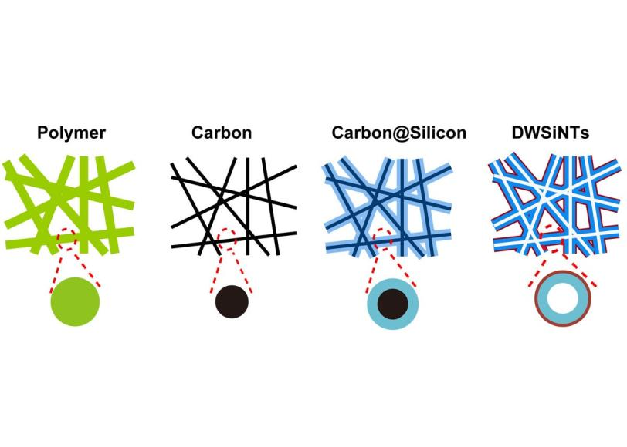
Hope for the Future
Solar and Wind?
“Free”, but intermittent
The science is in finding ways to store the energy
Hydrogen economy
Pumping water uphill
Compressed gas
Better batteries

Slide 45
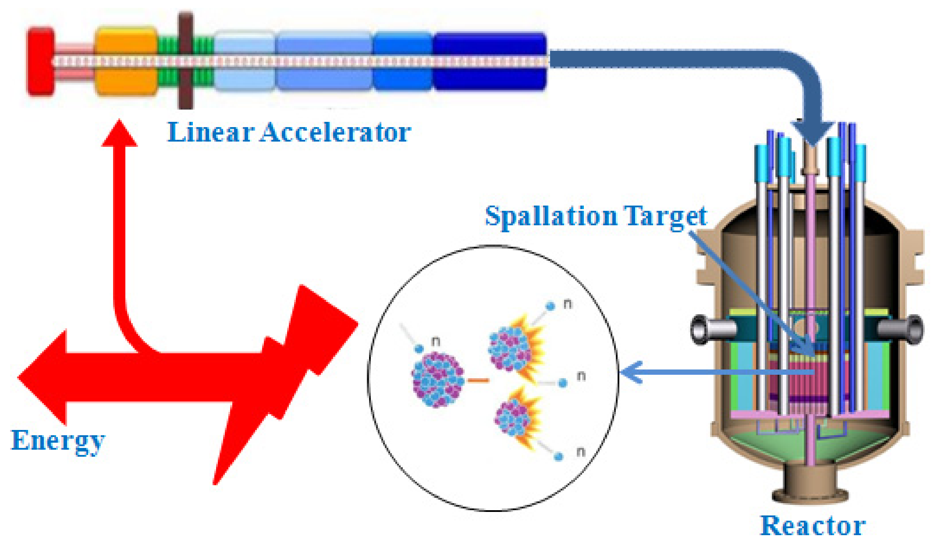
Hope (cont’d)
Accelerator-driven sub-critical systems
Use a particle beam to drive a sub-critical pile of fissionable material into criticality.
Pros:
Beam goes off -> reaction stops (no danger of a melt-down)
Can burn non-enriched fuel (no-proliferation danger)
Burns up long-lived waste
Cons:
Difficult and expensive.
This generating a lot of interest in India, because it can also burn thorium, which they have a LOT of.
Stay tuned…

Slide 46
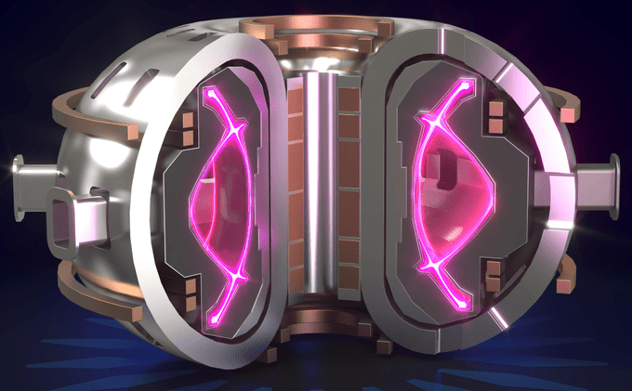
Compact Fusion Reactors
A number of companies are exploring compact fusion reactors as an alternative to ITER.
Some are straight up scams.
Others are sincere, but (IMHO) overly optimistic.
e.g. Commonwealth Fusion Systems, which spun off from MIT
Time will tell.

Slide 47
Some final comments
This is just the tip of the iceberg
Just go to YouTube and search for
Tom Bearden
Joe Newman
Stan Meyer
Bedini Motor
Or just “free energy”
Watch the videos and read the comments
Perpetual motion is just one facet of our society’s obsession with pseudo-science
Compare the Atsrology section of bookstore with the Science section.
We will never solve the daunting (and exciting) energy challenges facing us unless we first face reality.

Slide 48
Backup slides

Slide 49
But what about Jobs and Wozniac?
It’s important to make a distinction between “science” and “technology”
Science concerns the fundamental rules of nature
Technology is the application of these rules.
Science and technology are closely intertwined, but they are still distinct.
New science enables new technology
New technology is used to push the boundaries of science.
Although we live in a time of amazing technological advances, fundamental scientific advances are still few and far between.
Last new source of energy was nuclear power (early 20th century)

Slide 50
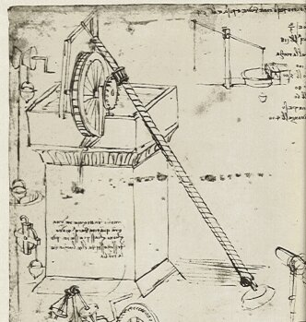
Leonardo da Vinci
Historians like to point out that Leonardo da Vinci spent a lot of time debunking things like Honnecourt’s wheel.
They usually leave out that he personally believed that the key to perpetual motion was some combination of a water wheel and an Archimedes screw.
Of course, there was no reason to believe this wouldn’t work – then
In fact, can you prove it now?

Slide 51
First: some acknowledgements
Donna Askins
This originally started as a proposed guest lecture for a class she was going to give at a local community college
Prof. Janet Conrad
For letting me try this lecture the first time at Columbia University.
Prof. Bob Park
For writing “Voodoo Science”
and a lifetime spent at the thankless task of trying to educate the public about science
Eric Krieg
Catalogs free energy claims and scams as a public service
Fermilab
For encouraging public outreach
Google, Wikipedia, and YouTube!!!

Slide 52
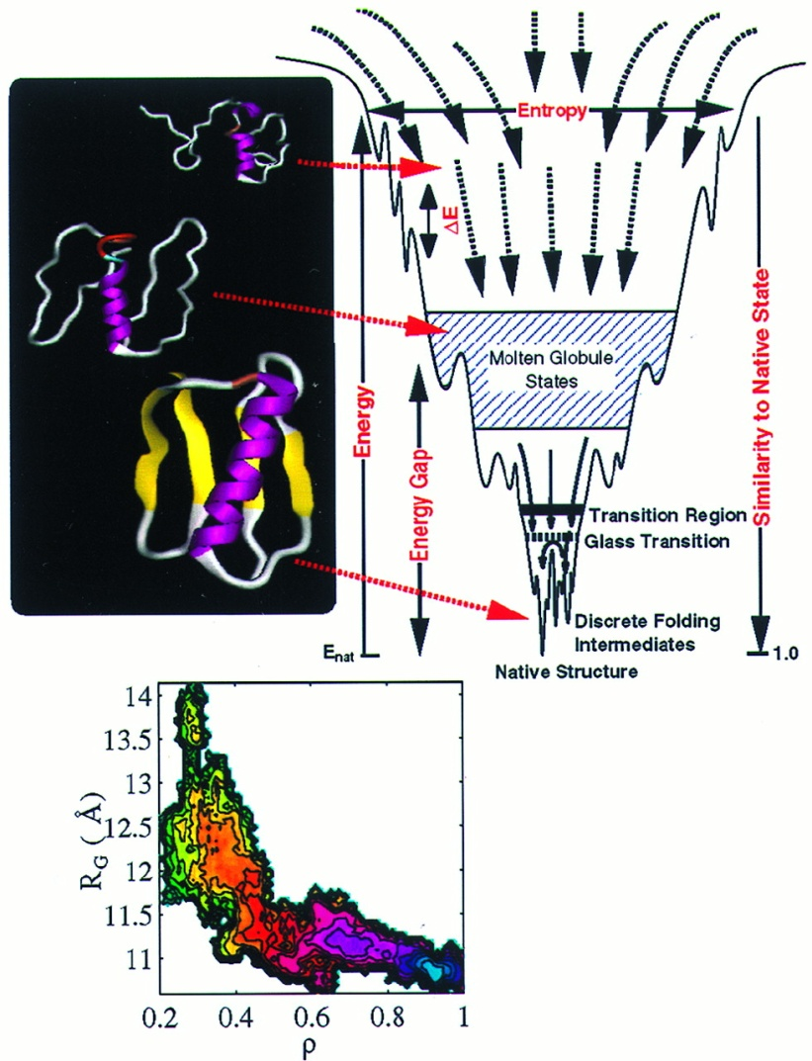
Generalization of Laws of Thermodynamics
Although the Laws of Thermodynamics were originally developed to described the flow of heat, the concepts of energy and entropy have been generalized to apply to every dynamic physical system:
Example: protein folding

Slide 53
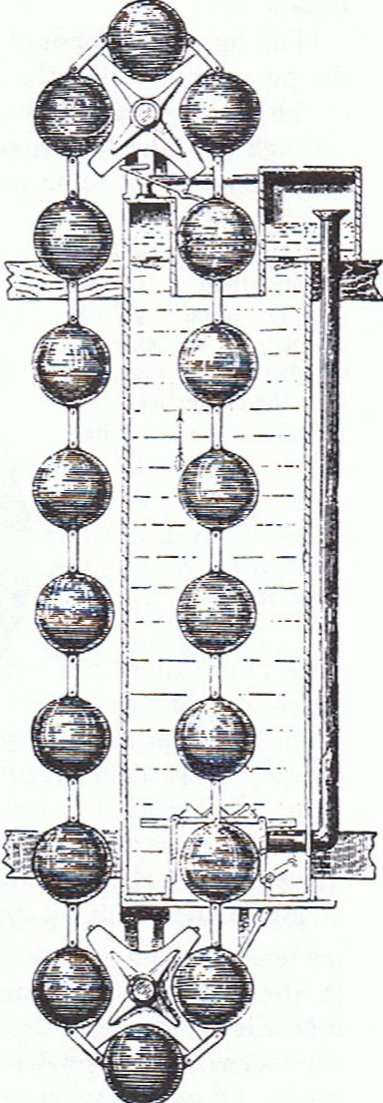
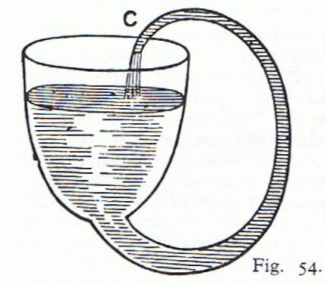
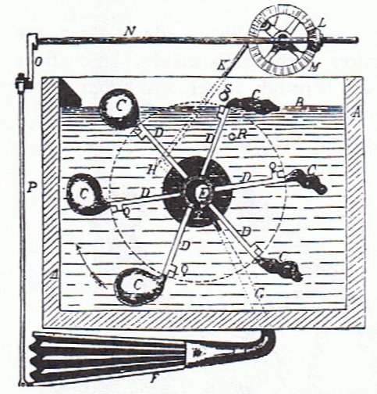
More ideas
Capillary action and buoyancy…

Slide 54
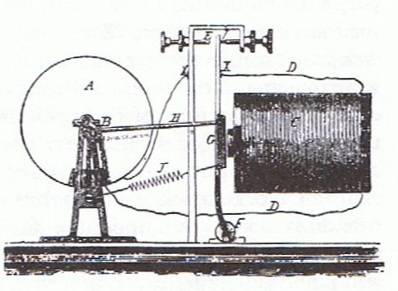
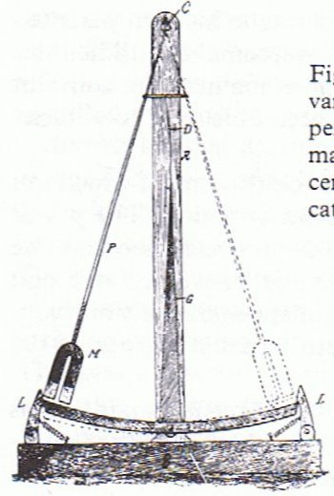
Hope springs eternal
Electricity/magnetism based…
As we’ll see, this is the class with the most staying power today

Slide 55
More about patents
Also from the Examiners’ Manual
“A rejection under 35 U.S.C. 101 for lack of utility should not be based on grounds that the invention is frivolous, fraudulent or against public policy.”
In a judicial case involving this statute, the judge ruled
“...we find no basis in section 101 to hold that inventions can be ruled unpatentable for lack of utility simply because they have the capacity to fool some members of the public.“
Translation: “The Patent Office will patent things even if it’s clear they will be used to defraud people”

Slide 56
The end(?) of Keely
After many years of delays, investors were becoming frustrated with Keely’s failure to produce a commercial device, and his refusal to allow independent testing.
They began withdrawing their investments and advising others to do the same.
Clara Bloomfield-Moore, a wealthy Philadelphia widow, came to the rescue with a large sum of cash and a monthly stipend.
However, she insisted on a review by the engineer E.A. Scott.
She dramatically reduced her support when it came back negative.
In 1890, Keely announced a new product, “The Liberator”, which would allow a motor to run on water.
Few people believed him.
Keely died a few years later

Slide 57
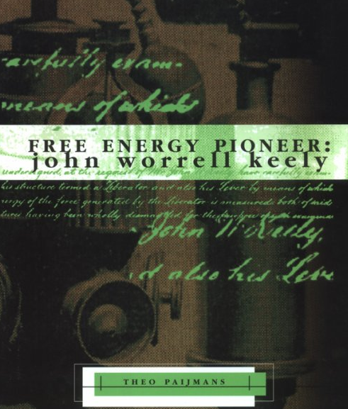
Keely today
Keely’s claims were thoroughly and completely debunked over a century ago.
Nevertheless, thousands of people still believe Keely held the key to limitless power and much more.
Example
“Over 100 years ago, John Ernst Worrell Keely (1827-1898), developed an advanced synthesis of science and philosophy. Keely was harnessing Sound, Light, Heart, Mind and Will to operate revolutionary new machinery and to improve Life and health. This is a science based on Natural Law governing Life, hope and Love and not Death, despair and destruction.”
- from the Sympathetic Vibration Physics website

Slide 58
Getting it wrong
Many of these people are quite sincere in their beliefs.
How can they get something as simple as conservation of energy so wrong?
A little knowledge is a dangerous thing.
One of the most common mistakes is to apply approximate physics formulae to situations where they aren’t relevant.

Slide 59
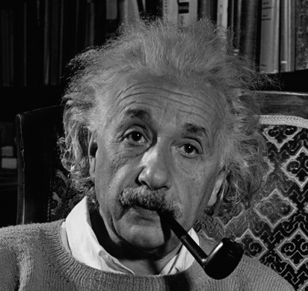
My World: Energy Conservation in Particle Decay
Einstein said
Particle at rest: E=Mc²
Particle in motion: E²=(Mc²)²+(pc)²
When a neutron decays (at rest)
momentum
Total
energy
conserved

Slide 60
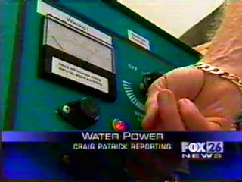
Energy from water*
*this is the clip that got me started on this crusade

Slide 61
Science and the media
With a few exceptions, when it comes to science, news media are awful.
When it comes to pseudo-science, the media are godawful.
When it comes to free energy con games, news media should arguably be charged as accomplices.
If you remember nothing else from this lecture, remember this:
No significant scientific result has ever been reported first by the evening news (or a YouTube video)!

Slide 62
What a good reporter might have noticed
If you could build a car that runs on water, why would you build a “gas-water hybrid”? Nostalgia?
They used “4 ounces of water”, but how much gas?
Do you have a lot of call to cut through charcoal?
Could it be the Oxygen was combining directly with the Carbon and the charcoal was simply burning itself?
Nothing magic about making a flame with Hydrogen from electrolysis.
Particularly with a unit the size of an arc-welder.
This sort of thing has been tried many times before
Google “Brown’s gas” or “Klein’s gas”, for example

Slide 63

Don't be fooled by technobabble
Sounds impressive…or at least incomprehensible

Slide 64
The claims in the video
“Standard electrodynamics assumes flat spacetime”
WRONG – electrodynamics works fine in curved spacetime, which leads to the bending of light
This was predicted by Einstein and experimental verified almost a century ago!
Reference to Lee and Yang
He seems to be confusing the 1957 Nobel Prize (Lee and Yang) for discovering “handedness” in weak interactions with the 1979 Nobel Prize (Glashow, Weinberg, Salam) for unifying electromagnetic and weak interaction by (among other things) interacting with the vacuum.
Of course, neither of these have anything to do with what he’s talking about.
The point is, there’s no content in this video or any of the dozens of others Bearden has produced.
It’s just scientific-sounding nonsense!

Slide 65
So how can you tell the difference…
…between real science, and scientific sounding jargon?
Science is very complex and specialized. Some things can really only be understood by experts.
For example, consider the two journal articles
Even scientists sometimes have to avoid the “Emperor's New Clothes” syndrome.
Chang and Georgi, “Quantum modified mooses”
Nuclear Physics B672 (2003)
Ganfornina and Valdes, “Studies on the Tsagas-Sourlas-Santilli Isotopology”
Algebras, Groups, and Geometries (2003)
Real paper by real physicists in a respected journal (Nucl. Phys. B)
Nonsense, self-published by kooks

Slide 66
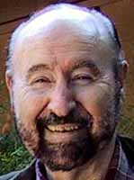
Who is Tom Bearden?
In short, he’s the cult figure in the free energy community:
Next to Tesla, of course
He has a B.S. in Math from Northeastern Louisiana University, and a Master’s in Nuclear Engineering from the Georgia Institute Technology.
He retired from the Army at the rank of Colonel
This appears to have been his only real job .
For a while he identified himself as “Thomas Bearden, PhD”
His PhD turned out to be purchased from “Trinity College and University” – a notorious degree mill.
He’s back to just “Thomas Bearden” - usually

Slide 67
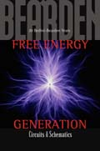




Bearden's claims
For decades, Bearden has been making numerous claims involving “over-unity” physics (he avoids the term “perpetual motion”)
Claims that these technologies are being suppressed by governments and special interests
He has written at least 10 books on free energy, conspiracy theories, AIDS
For example, he believes both the Challenger accident and Chernobyl were triggered by secret “scalar wave” weapons.
… and one on Aikido

Slide 68

The "science" of Tom Bearden
Bearden supports his claims with a random stream of physics jargon and famous names:
“Zero Point energy”, “Scalar waves”, “Nikola Tesla”, “broken symmetry”, “Aharonov-Bohm Effect”, etc, etc, etc.
One analysis of his theories (by real physicists) described them as:
"full of misconceptions and misunderstandings concerning the theory of the electromagnetic field”
- Carvalho and Rodrigues, “The non sequitur mathematics and physics of the New Electrodynamics proposed by the AIAS group"

Slide 69

The motionless electric generator (MEG)
Patented in 2002 by a group led by Bearden.
Purports to be a device for extracting energy from the vacuum (or from “scalar waves”, the explanation is not clear).
In 2002, Bearden promised a commercial model in “a year or so”
As of 2005, he claimed he still needed “$10-$12 million dollars” to develop the MEG into a commercial product.
It’s not clear what the money is for, since he claims it has already produced “100 times more energy than was input”.
To date, there is still no commercial product.
Independent analyst essentially describe it as “a fancy transformer”.
Cited by many as “absolute proof” of “over-unity” physics.

Slide 70
Other claims by Bearden*
Numerous “over-unity” technologies exist, but are actively suppressed by government or special interests, using means up to and including murder.
Believes that something called “scalar waves” are being secretly developed as a weapon, and in fact are responible for:
Cernobyl
The disintegration of the space shuttle Challenger
The 2001 Indonesian tsumani
Hurricane Katrina, which was engineered by a combination of the KGB, the Japanese Yakuza, and remaining members of the Aum Shinrikyo cult
What conclusion would you draw about the guy?
*from his website http://www.cheniere.org/

Slide 71

Example: complex waveforms
For a sine wave
but for a square wave
No simple formula works all the time.

Slide 72
Prosecuting energy con men
Kelly was convicted for misappropriating corporate funds for personal expenditures (houses, credit cards for his daughter, etc)
Only accused of mishandling about 10% of investment money.
Ultimately irrelevant that the technology was bogus
Difficult to prosecute based on scientific claims. Must prove:
Technology doesn’t work
Technology can’t possibly work
The people asking for your money know this
Most con men are smarter than Kelly
Classify investments as “venture capital”
Pay themselves a large salary
Divert a little money to meaningless “R&D”
Continue with impunity

Slide 73


Can it be that simple?
Power circuit from Stan Meyer’s “Water Fuel Cell”
Electrolysis driving waveform
All “over-unity” claims regarding Meyer’s cell result from erroneous evaluation of the power in this complex waveform.
Complicated waveforms are a very common feature of “over-unity” circuits.

